Slide 1
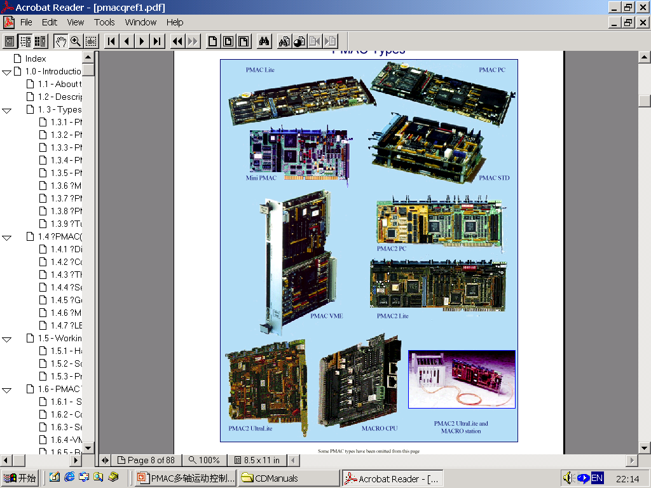
E-MOTION
PMAC多轴运动控制卡
（中级培训）

Slide 2
LINEAR 插补方式
对PMAC 用户直线插补是最通用的方式. 直线插补轨迹包括加减速时间和运动时间.
需要学习:
  什么是直线插补模式的轨迹
  如何改变轨迹的特征
  如何实现多个运动的速度混合

Slide 3
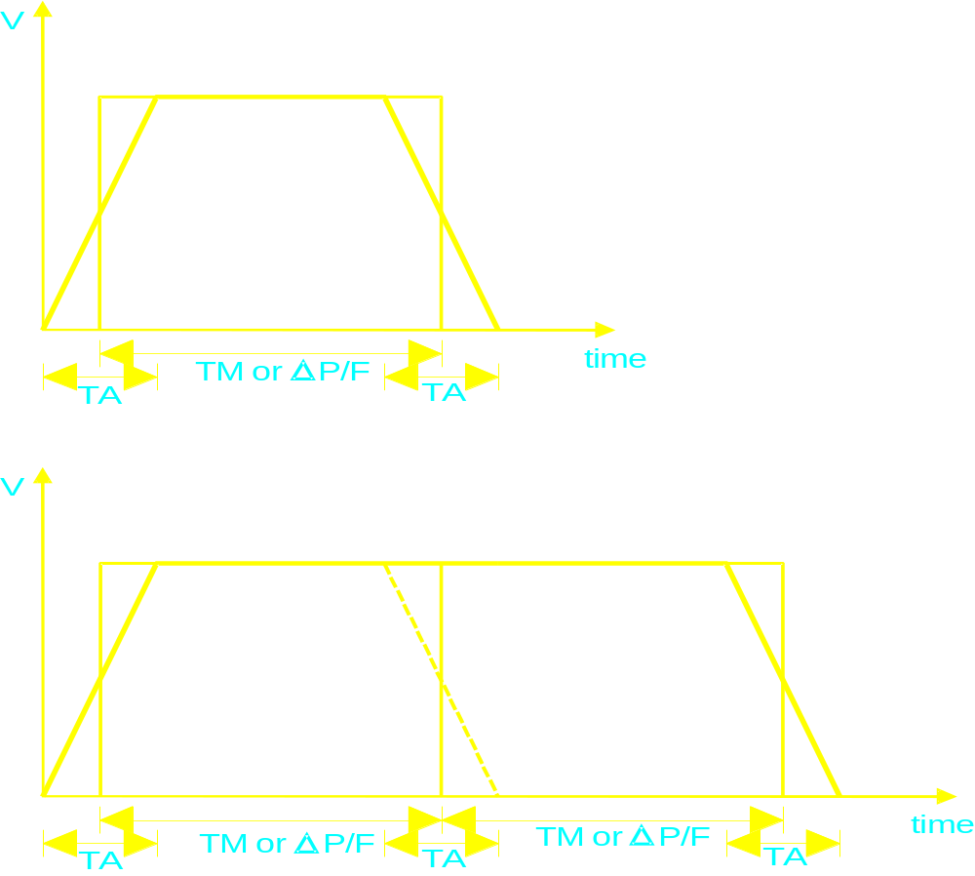
Linear 模式的轨迹
小Acceleration 时间

Slide 4
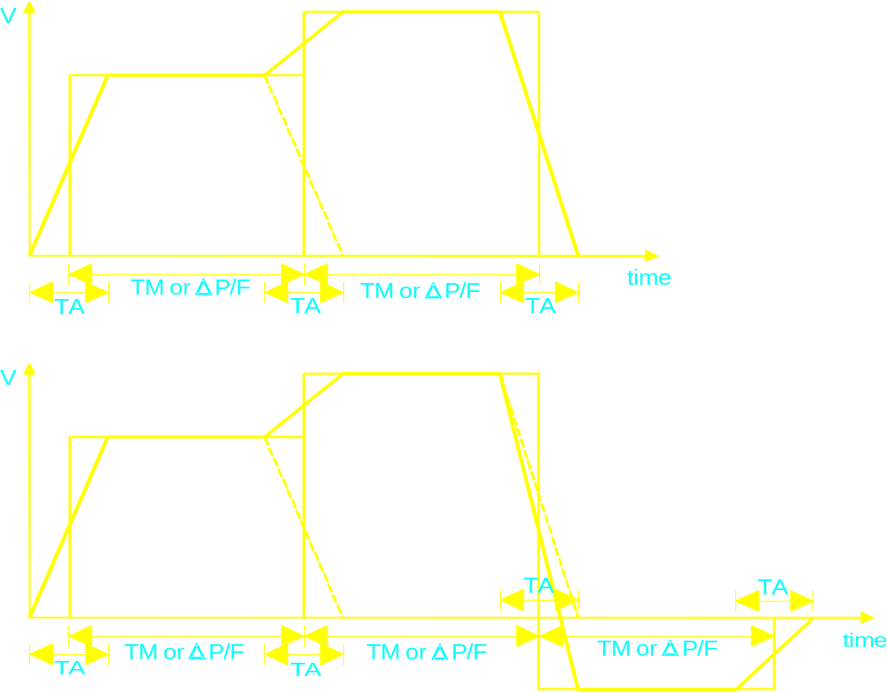
Linear 模式的轨迹(continued)
小Acceleration 时间

Slide 5
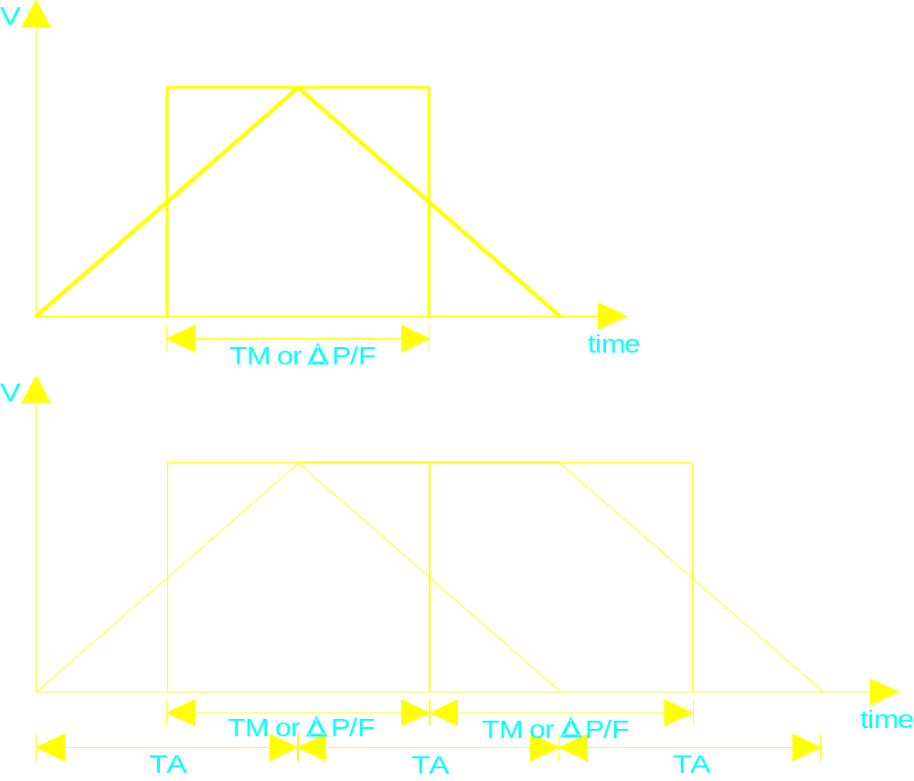
Linear 模式的轨迹(continued)
加速时间等于运动时间

Slide 6
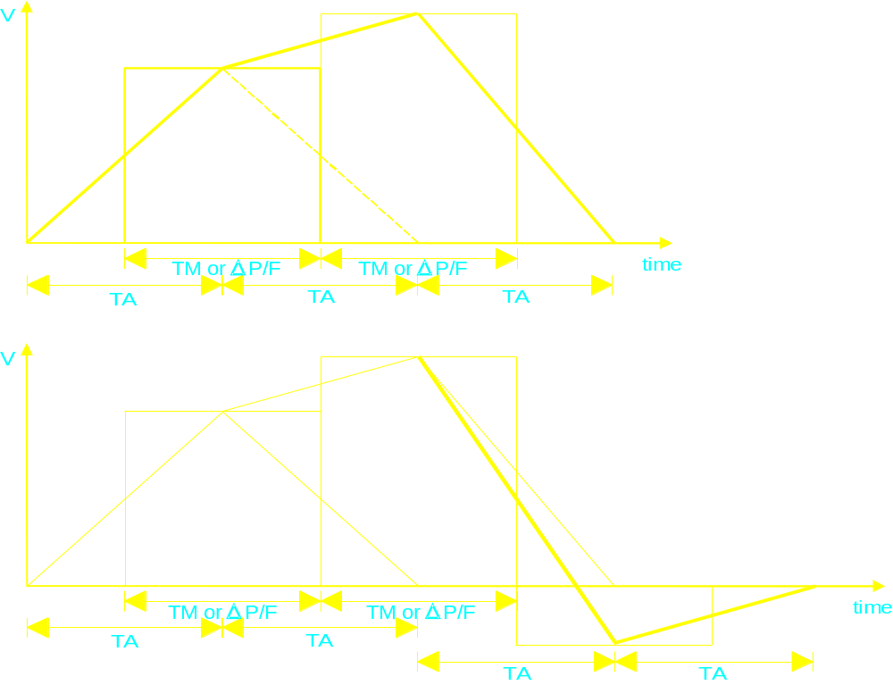
Linear 模式的轨迹(continued)
加速时间等于运动时间

Slide 7
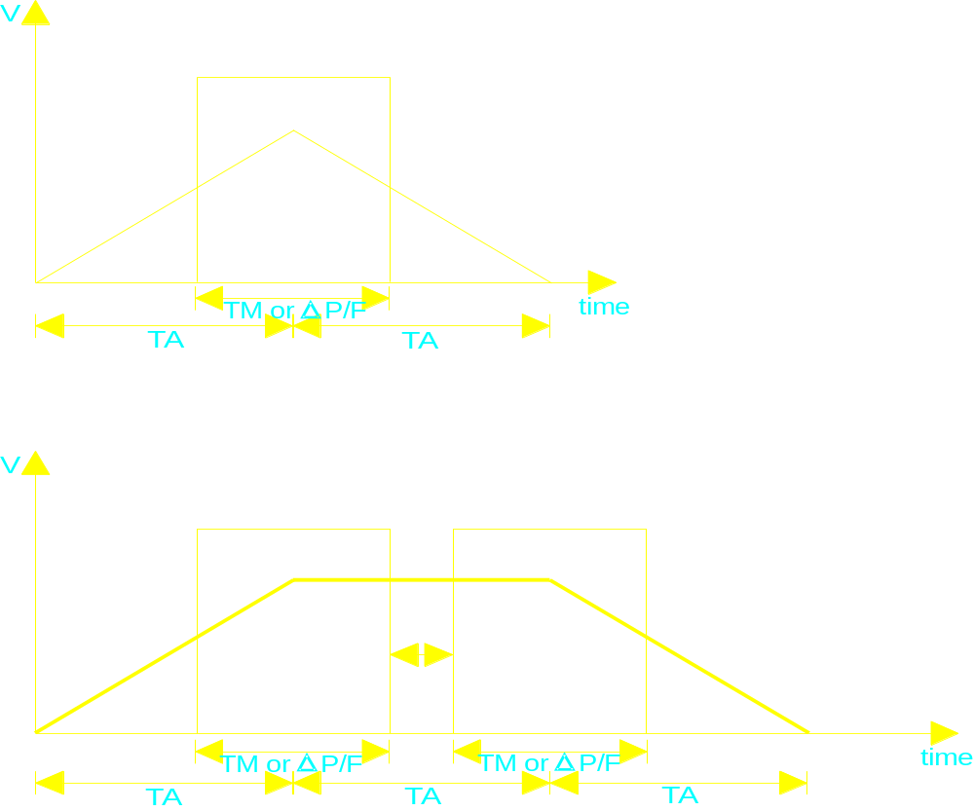
Linear 模式的轨迹
大 (速度限制) 加速时间

Slide 8
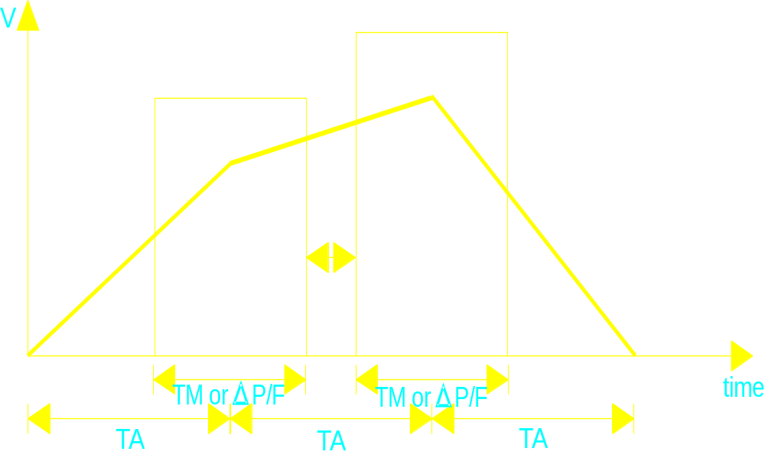
Linear 模式的轨迹
大 (速度限制) 加速时间

Slide 9
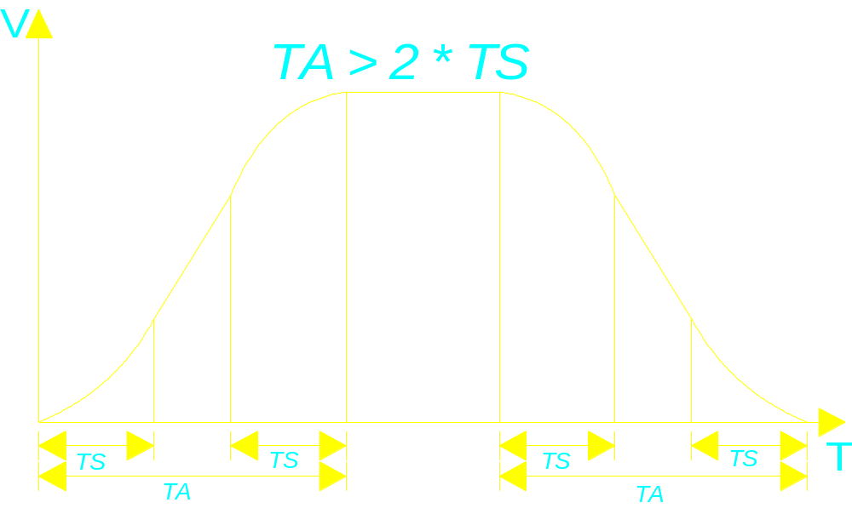
加速参数
TA 编程加速时间
(单位: msec); 整数
TS 编程S-曲线时间
(单位: msec); 整数

Slide 10
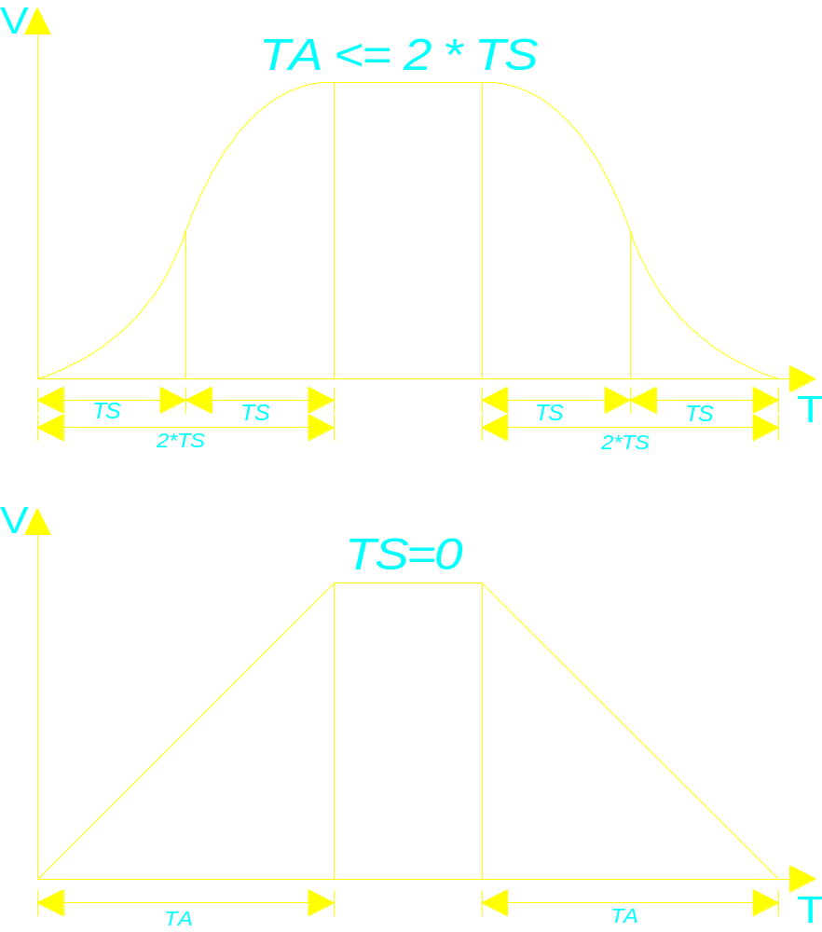
加速参数(continued)

Slide 11
例 3: 一个复杂的运动
This example introduces incremental and time-specification of moves, looping logic, using variables, scaling of axes, and simple arithmetic. Note that logical and mathematical operations do not delay moves.
;******************** Set-up and Definitions ********************
&1 ; Coordinate system 1
CLOSE ; Make sure all buffers are closed
#1->1000X ; 1 unit (cm) of X is 1000 counts of motor 1
;******************** Motion Program Text ***********************
OPEN PROG 2 ; Open buffer for entry, Program #2
CLEAR ; Erase existing contents of buffer
LINEAR ; Blended linear interpolation move mode
INC ; Incremental mode - moves specified by distance
TA500 ; 1/2 sec (500 msec) acceleration time
TS250 ; 1/4 sec in each half of S-curve
TM2000 ; 2 sec move time (to start of decel)
P1=0 ; Initialize a loop counter variable
WHILE (P1<10) ; Loop until condition is false (10 times)
X10 ; Move X-axis 10 cm (=10,000 cts) positive
DWELL500 ; Hold position for 1/2 sec
X-10 ; Move X-axis back 10 cm negative
DWELL500 ; Hold position for 1/2 sec
P1=P1+1 ; Increment loop counter
ENDWHILE ; End of loop
CLOSE ; Close buffer - end of program
运行程序:
&1 B2 R ; 坐标系1, 指向运动程序2,运行

Slide 12
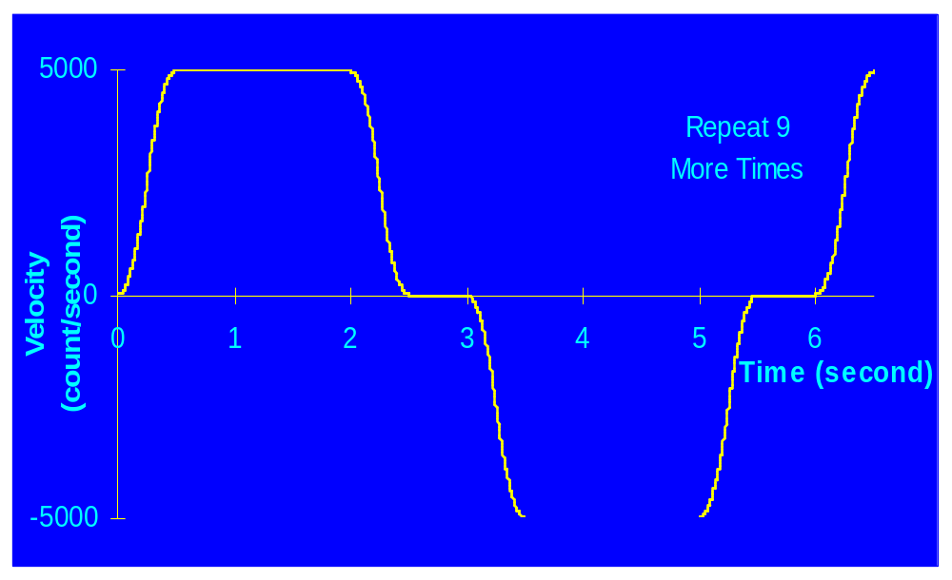
例 3: 一个复杂的运动

Slide 13
直线插补测验
曲线的水平和垂直轴的含义?
什么是 TS, TA, TM and F?
TM 和 F 的关系是什么?
以100msTA时间和20ms的TS时间，TM为500ms的时间外成一个运动，总的运动时间是多少?
如果程序表达 TS100 TA100 TM100，完成3个混合运动的总时间是多少?

Slide 14

PMAC 运动速度混合
PMAC 在如下情况下速度无法混合:
  两个运动指令中间有 DWELL指令
  2 个向后跳转指令 (GOTO, ENDW)
  速度混合功能无效设定 (Ix92=1)

Slide 15
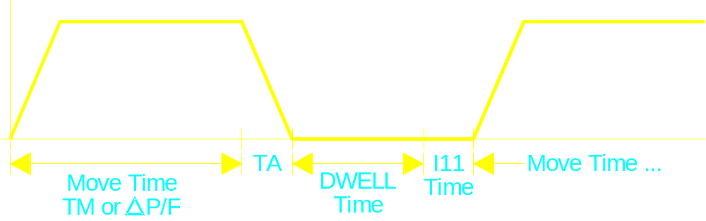
DWELL Vs. DELAY
DWELL
  总使用固定的时基 (I10)
  暂停时间不包括减速过程
  直到DWELL结束才执行下面运动的计算 (add I11 time)

Slide 16
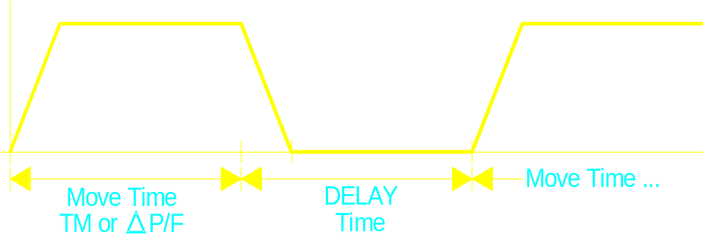
DWELL Vs. DELAY (continued)
DELAY
  使用可变的时基 (% value)
  暂停时间包括减速过程
  最小暂停时间是当前 TA时间
  下面运动时间开始于DELAY指令

Slide 17
例4: 速度混合有效的例程
This example shows how to program a blended move on the PMAC and the function of Ix92. First the program specifies how to do the move, then commands the move.
******************* Set-up and Definitions *******************
DEL GAT ; Erase any defined gather buffer
&1 ; Coordinate System 1
CLOSE ; Make sure all buffers are closed
#1->X ; Assign motor 1 to the X-axis - 1 program unit
; of X is 1 encoder count of motor #1
I192=0 ; Enable blending
******************* Motion Program Text **********************
OPEN PROG 1 ; Open buffer for program entry, Program #1
CLEAR ; Erase existing contents of buffer
LINEAR ; Blended linear interpolation move mode
ABS ; Absolute mode - moves specified by position
TA500 ; Set 1/2 sec (500 msec) acceleration time
TS0 ; Set no S-curve acceleration time
F5000 ; Set feedrate (speed) of 5000 units(cts)/sec
X10000 ; Move X-axis to position 10000
X20000 ; Move X-axis to position 20000
X30000 ; Move X-axis to position 30000
DWELL0 ; Stop program lookahead
CMD"ENDG" ; Send On-line command to stop data gathering
CLOSE ; Close buffer - end of program
To run this program:
DEF GAT<CR>
GAT &1 B1 R ; GATHER, CS. 1, point to Beginning of Program 1, Run

Slide 18
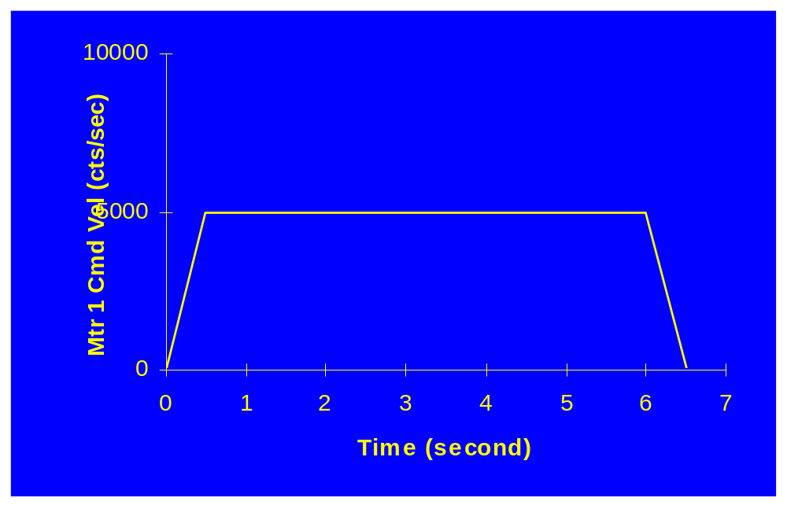
例4: 速度混合有效的例程

Slide 19
例5: 速度混合无效的例程
This example shows how to program moves on the PMAC and the function of Ix92. First the program specifies how to do the move, then commands the move.
******************* Set-up and Definitions *******************
DEL GAT ; Erase any defined gather buffer
&1 ; Coordinate System 1
CLOSE ; Make sure all buffers are closed
#1->X ; Assign motor 1 to the X-axis - 1 program unit
; of X is 1 encoder count of motor #1
I192=1 ; Disable blending
******************* Motion Program Text **********************
OPEN PROG 1 ; Open buffer for program entry, Program #1
CLEAR ; Erase existing contents of buffer
LINEAR ; Blended linear interpolation move mode
ABS ; Absolute mode - moves specified by position
TA500 ; Set 1/2 sec (500 msec) acceleration time
TS0 ; Set no S-curve acceleration time
F5000 ; Set feedrate (speed) of 5000 units(cts)/sec
X10000 ; Move X-axis to position 10000
X20000 ; Move X-axis to position 20000
X30000 ; Move X-axis to position 30000
DWELL0 ; Stop program lookahead
CMD"ENDG" ; Send On-line command to stop data gathering
CLOSE ; Close buffer - end of program
To run this program:
DEF GAT<CR>
GAT &1 B1 R ; GATHER, CS. 1, point to Beginning of Program 1, Run

Slide 20
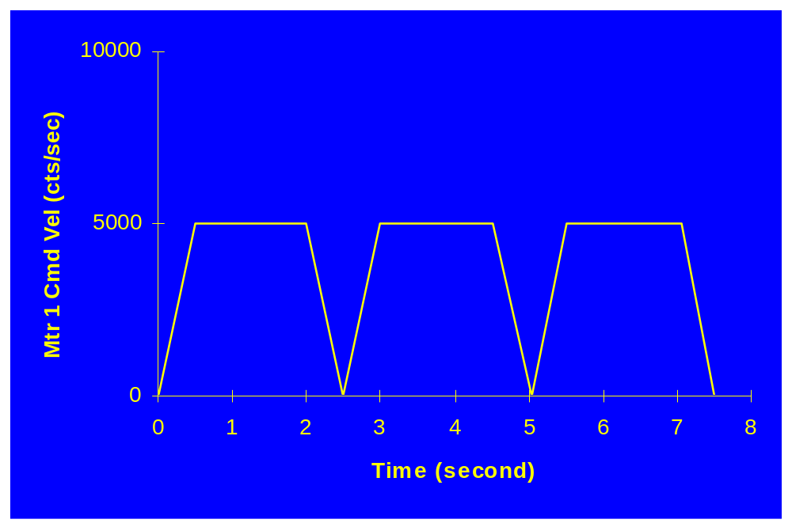
例5: 速度混合无效的例程

Slide 21
速度混合测验
使用 速度指令 (F) 在增量方式 (INC) ，指令 X1000 和指令 X100 X400 X500如果 Ix92=0, TA< TM or (TA<ΔP/F), 和 2×TS<TA有何区别?

Slide 22
矢量速率
PMAC 可以自动计算运动时间（TM)使电机运行与希望的速度速率下.
这用于多个电机在一个坐标系下控制一个刀具，来自动分配各自的速度
需要学习:
  速率指令的表达
  PMAC如何计算速率

Slide 23
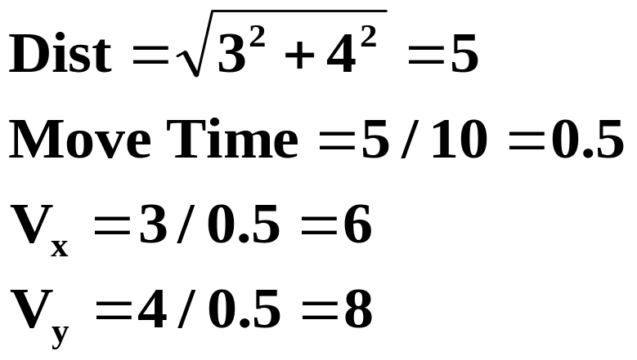
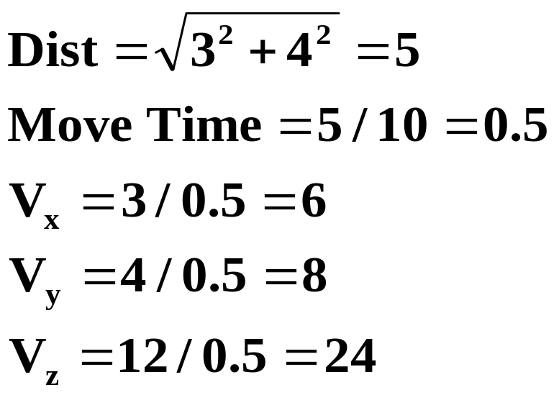
矢量速度轴
INC
FRAX (X,Y)
X3 Y4 F10
INC
FRAX (X,Y)
X3 Y4 Z12 F10

Slide 24
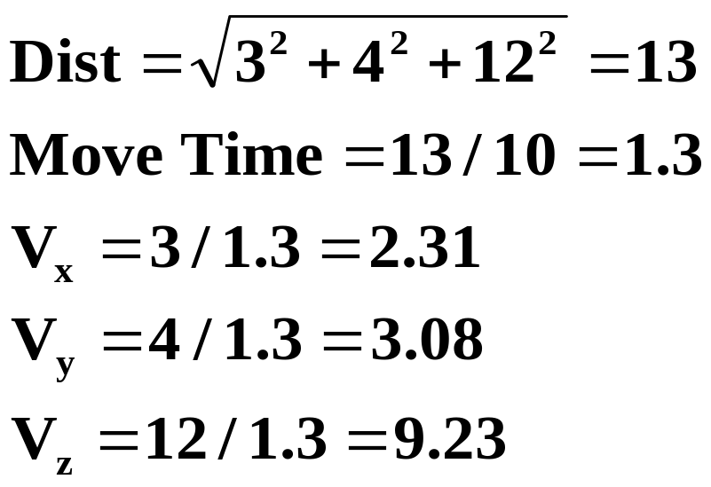
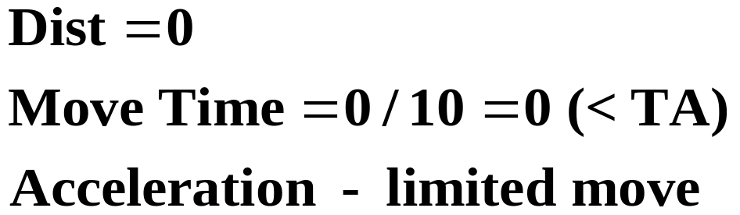
矢量速度轴(续)
INC
FRAX (X,Y,Z)
X3 Y4 Z12 F10
INC
FRAX (X,Y)
C10 F10

Slide 25


速度时间单位
Ix90 速度时间单位
(单位: msec)
例: #1 -> 2000X
Ix90 = 1000

Slide 26
速率测验
如果坐标系1 的 I190=60000，那么速率时间单位是什么?
如果X 和 Y 是速率轴, 如果指令 X100 Y200，各自速度如何分配?
如果你编程指令 F5 定义速度为 5 inches/sec,如何设定 Ix90和轴的定义?

Slide 27
Exercise 1: Indexing a Motor
Problem:
You have been asked to use PMAC in an indexing application, PMAC must index motor #1, which drives a leadscrew, a distance of 10 cm, pause at this location for 4 seconds then return to its original location. Each of the moves must take place in 2 seconds.
The program will be started by an ASCII command string sent to PMAC from a Programmable Logic Controller over the RS232 port.
Hardware:
2000 counts per revolution encoder
5:1 gear reduction
1cm/rev pitch leadscrew
SET Ix92=0 to enable blending

Slide 28
Exercise 2: Indexing a Motor
Problem:
As is the case with all applications, the requirements have been changed. The following must be added to the basic requirements of exercise 1.
The desired motion profile has been changed. The system must now move from its zero location to 10 cm, pause for 4 seconds and then move to 20 cm in 2 more seconds and pause for 1 second. It then must return to 0 cm in 1.5 seconds.
The system has now become a multi-axis project. Not one but four identical leadscrews must simultaneously execute this profile.

Slide 29
Exercise 2: Indexing a Motor (continued)
To minimize wear and tear on the mechanical components, instantaneous changes in acceleration (jerk) must be eliminated.
This machine will be sold to a European company which will write some new programs for it. They only want to program in centimeters so your programs must also use centimeters.
A feedrate override switch has also been added to the system. Your programmed pauses must now change as the feedrate override changes. This means that a 1.5 second pause will last 3 seconds at 50% feedrate override. Use M197->X:$0806,0,24,s for feedrate override control.

Slide 30
Exercise 3: Conditional Branching
Problem:
The European Company is having a lot of success with your machine and your boss now has some extra R&D money. He wants you to write another application based on the same platform.
2 input switches have been connected to PMAC’s machine inputs 1 and 2. He wants these switches to control the motion of the stages as follows.
If machine input 1 is on, the stages should move from 0 cm to 10 cm at a speed of 1 cm/sec, pause for 1 second then return to 0 cm at the same speed and pause for 100 milliseconds until looking for the next input.

Slide 31
Exercise 3: Conditional Branching (continued)
If machine input 2 is on, the stages should move from 0 cm to -10 cm at a speed of 2 cm/sec, pause for 1 second then return to 0 cm at the same speed and pause for 100 milliseconds until looking for the next input.
If both machine inputs 1 and 2 are on, or if neither are on, the stages should not move from 0 cm and should pause for 100 milliseconds until looking for the next input.

Slide 32
圆弧插补
PMAC 允许 X,Y, 和 Z 轴在一个坐标系下执行圆弧插补指令。
TS 可控制起始和结束的加减速时间. 圆弧插补的混合速度由指令(F) 或时间 TM来定义.
需要学习:
什么变量控制圆弧插补
如何使用圆弧插补
如何定义插补平面

Slide 33
圆弧插补
圆弧插补的通常定义:
1) 运动分段时间 Typical value: I13 = 10
2) 插补平面定义 NORMAL {vector} {data} …
3) 终点坐标定义方式 ABS
INC
(4) 圆心矢量的定义方式 ABS ( R )
(if vector mode definition is used) INC ( R )
(5) 圆弧方向定义 CIRCLE 1
CIRCLE 2
(6 ) 圆弧指令 X{Data} Y{Data} I{Data} J{Data}
X{Data} Y{Data} R{Data}
例:
I13=10 ;Move Segmentation Time
NORMAL K-1 ;XY plane
INC ;Incremental End Point definition
INC(R) ;Incremental Center Vector definition
CIRCLE 1 ;Clockwise circle
X20 Y0 I10 J0 ;Arc move
Center (10,0)
Start (0,0)
End (20,0)

Slide 34
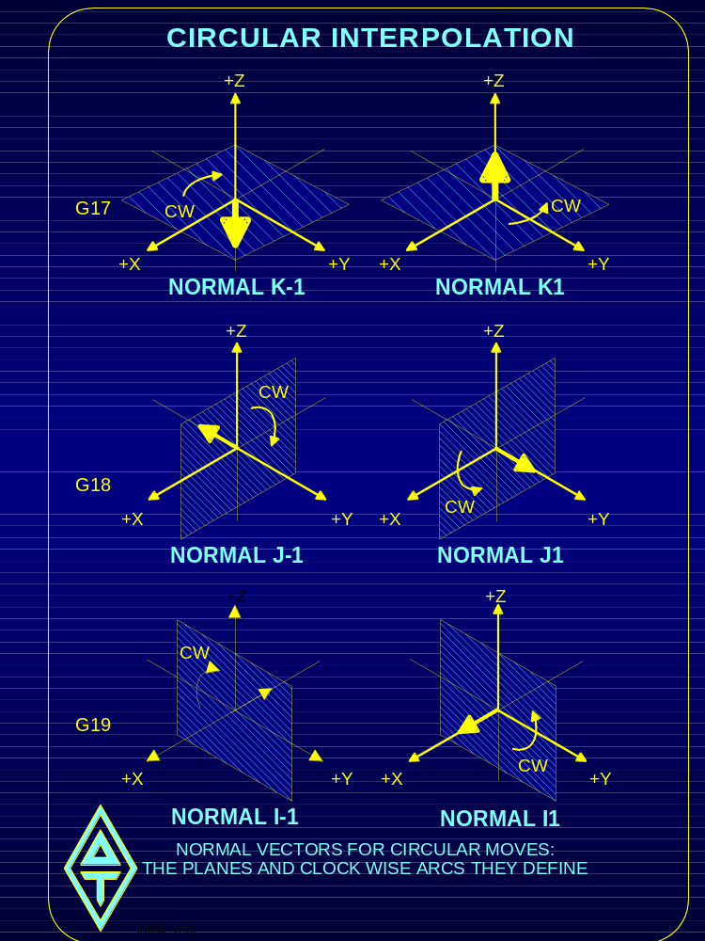

Slide 35
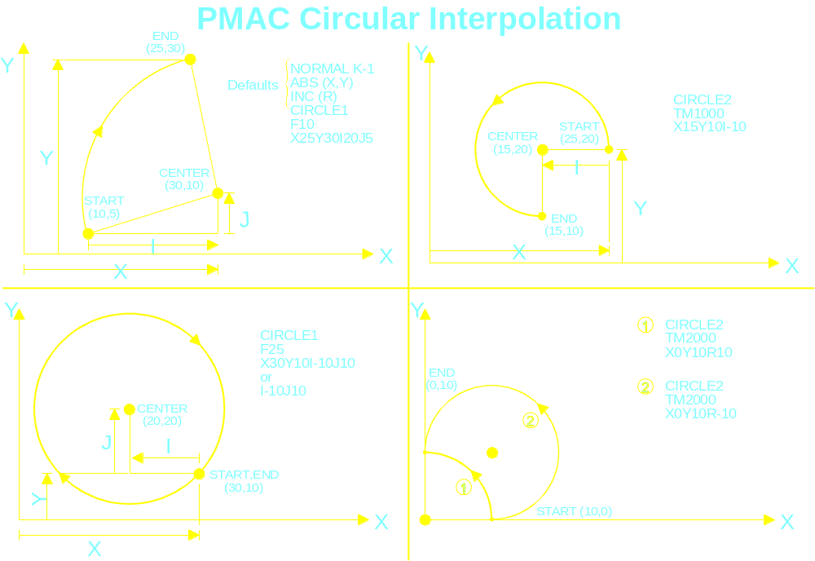

Slide 36
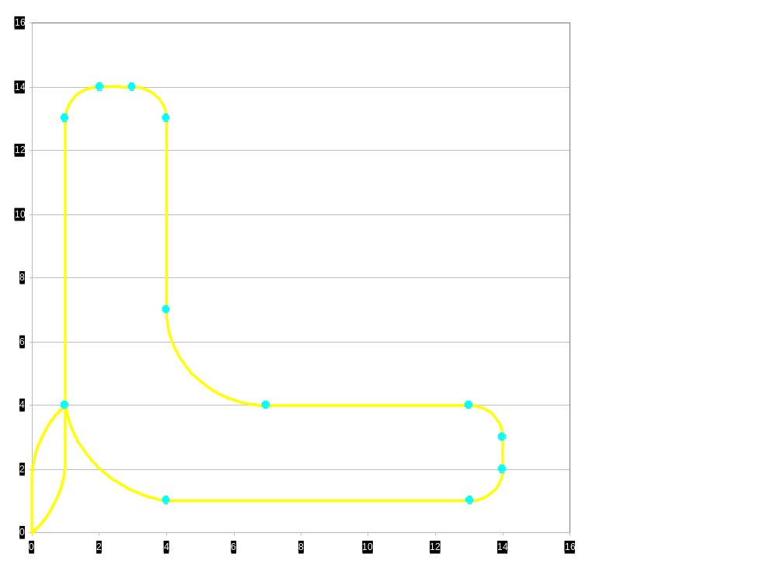
圆弧插补例程
;Setup and definitions
&1
#3->10000x
#4->10000y
i13=10
;Motion Program Text
open prog4 clear
normal K-1
rapid x1 y4
f5
linear y13
circle1 x2 y14 i1 j0
linear x3
circle1 x4 y13 i0 j-1
linear y7
circle2 x7 y4 i3 j0
linear x13
circle1 x14 y3 i0 j-1
linear y2
circle1 x13 y1 i-1 j0
linear x4
circle1 x1 y4 i0 j4
dwell100
rapid x0 y0
close

Slide 37
提前运算（前瞻功能）PRECALCULATION
在 blend 和 spline 运动中, 运动程序必须将当前运动
后几步的运动指令提前进行运算.
根据不同的运动模式，在程序运行中将进行0，1，或2
段运动指令的前瞻计算.
我们将要学习:
前瞻功能做了些什么？
怎样停止前瞻功能？
如何使用同步变量？

Slide 38
PRECALCULATION
All program calculations and assignments, except for
synchronous M-variable assignments, between the move
in progress and the move being calculated are performed
one line at a time during the look-ahead.
This may be a problem with M-variables, particularly outputs,
as the action will take place sooner than expected.
Example: LINEAR ;linear move mode
X10 ;move X-axis to 10
X20 ;move X-axis to 20
M1=1 ;turn on output #1
X50 ;move X-axis to 50
The output M1 will be turned on at the beginning of the X10
move due to PMAC’s precalculation of the program

Slide 39
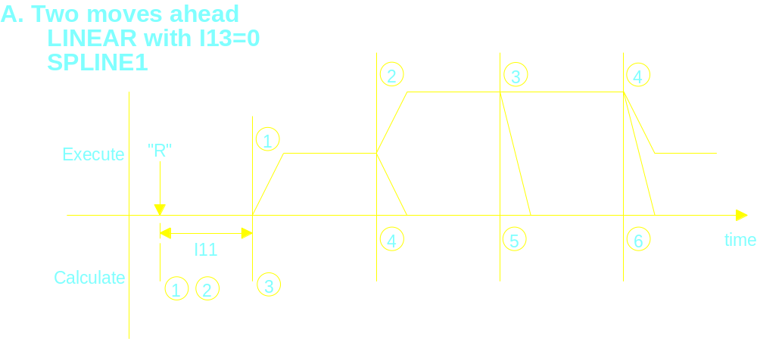
PMAC Motion Program Precalculation

Slide 40
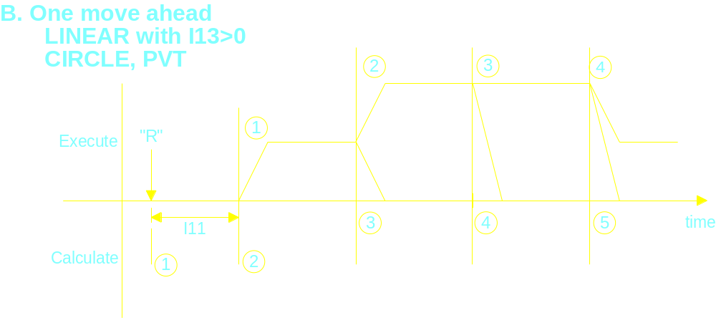
PMAC Motion Program Precalculation

Slide 41
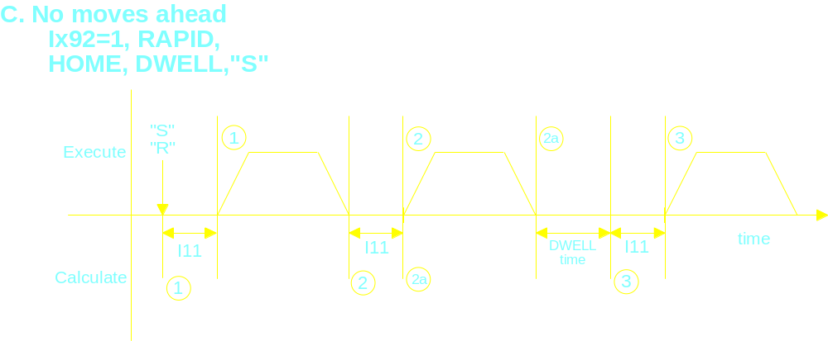
PMAC Motion Program Precalculation

Slide 42
同步 M-变量
Synchronous M-Variables assignments are a solution to the
synchronization problems caused by move precalculation.
When a Synchronous M-variable assignment is encountered,
it is not executed immediately; but put on a stack for execution at
the start of the next move in the program. Output actions are thus
synchronized with the motion action
Example: LINEAR ;linear move mode
X10 ;move X-axis to 10
X20 ;move X-axis to 20
M1==1 ;turn on output #1
X50 ;move X-axis to 50
The statement M1==1 is encountered at the beginning of the move to X10, but the action is not performed until the start of blending into the move X50

Slide 43
MACROS
Macros allow you to assign a specific name to a PMAC variable
or command for programming purposes. For example, you can
define the word PUMP_PRESSURE to the variable P10.
This allows you to use meaningful names in your programs which
simplifies programming and memory management.
Macros are a feature of the Executive Program and are not a
PMAC feature. When a file with Macros is downloaded to PMAC,
the executive program substitutes the appropriate PMAC
commands or variables in place of the Macros. PMAC only sees
the PMAC commands and variables.

Slide 44
PMAC 计算优先级
1. Single character I/O 单字符I/O
Serial, PC-bus, STD-bus; 200ns/char
2. Commutation Update换相更新率
E29-E33 set (9KHz default); 3usec/axis
3. Servo Update伺服更新率
E3-E6 set freq (2.25KHz default);30usec/axis
4. Real Time Interrupt实时中断
I8 设定频率; 循环于:
A. 运动程序的计算
每次新运动的开始; 1 or 2 步提前
B. PLC0
当不执行运动程序
C. PLCC0
D. Dual Ported RAM双端口RAM
Servo data buffers伺服数据存储器

Slide 45
PMAC 计算优先级
5. VME mailbox处理器
事件驱动
6. 后台任务
Done in time left over; rotates between:
A. Communication line processing
Event driven
B. PLC1-31
one at a time
C. PLCC
one scan through all PLCC’s
D. General Housekeeping
E. Dual Ported RAM Data Buffers

Slide 46
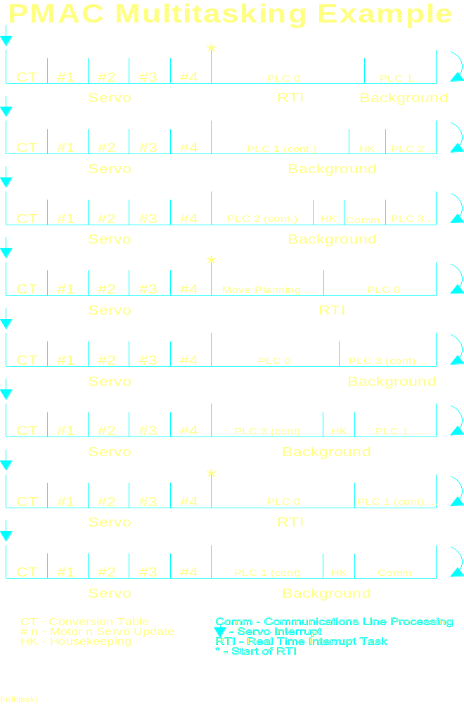

Slide 47
PMAC 看门狗计时器
No
Frequency > 25Hz
Yes
Watchdog
Timer Satisfied
Turn Off Card
No
DC Voltage > 4.75
Yes
PMAC algorithm to assure Watchdog gets 25 Hz signal
and check for a minimum of 4.75V to the memory chips.

Slide 48
PMAC 看门狗计时器(续.)
Real Time Interrupt
Read W.D Register
Background Tasks
are not occurring
often enough, there-
fore stop updating
timer
Is Register > 0
Decrement W.D.
Timer Register
PMAC algorithm to assure Watchdog gets 25 Hz signal.
This ensures both background and foreground tasks are
done reasonably often.

Slide 49
通讯控制 I-变量
I1: 串口模式
= 0, 2 :Host CS hand shake used
= 1, 3 :Host CS hand shake disabled
= 2, 3: Multiple card daisy chain enabled
I3: 握手字符控制
= 1: <LF> sent to acknowledge valid command
= 2, 3: <ACK> sent to acknowledge valid command
= 1, 3: <LF> precedes data response line
I4: 通讯完整性模式
= 0, 2 :Checksum disabled
= 1, 3: Checksum enabled
= 0,1 : Serial errors reported immediately
= 2, 3: Serial errors reported at end of line
I6: 错误报告模式
= 0, 2: Returns <BELL> character
= 1, 3: Reports error number

Slide 50
Communications Control I-Variables
I9: Data Reporting Form
= 1, 3: Long form data reporting
= 2, 3: Hexadecimal address I-variable reporting
I58: DPRAM ASCII Communications
= 0: Disables DPRAM communication
= 1: Enables DPRAM communication
I56: DPRAM ASCII Communications Interrupt Enable
= 0: Disables communications interrupt
= 1: Enables communications interrupt

Slide 51
ACC-26A
RS422/232 TO RS232
OPTICALLY ISOLATED CONVERTER
BOARD
MCC
SMCC
PMAC-PC
TO PC-AT (RS232C)
PMAC-VME
PMAC-Lite RS422
J1
CTS
RXD/
J5
1
E1A
U1
RTS
TXD/
E1D
1
J2
GE FANUC
MC34050
1
90-70
RP1
RP2
RP3
3.88 in. (98.55 mm)
TO PC-XT
U2
(RS232C)
PMAC-Lite
1
E3
PMAC-STD32
1
E4
MAX232
(REQUIRES SPECIAL CABLE)
1
2
J4
D10
TB1
J3
4.25 in. (107 mm.)
FOR RS-422 INSTALL U1, RP1, RP2, RP3, REMOVE U2
FOR RS-232 INSTALL U2, REMOVE U1, RP1, RP2, & RP3

Slide 52
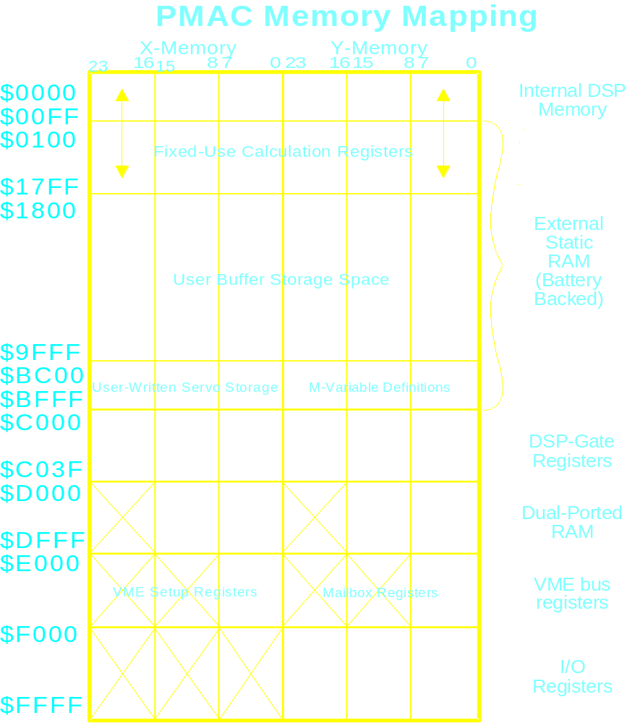

Slide 53
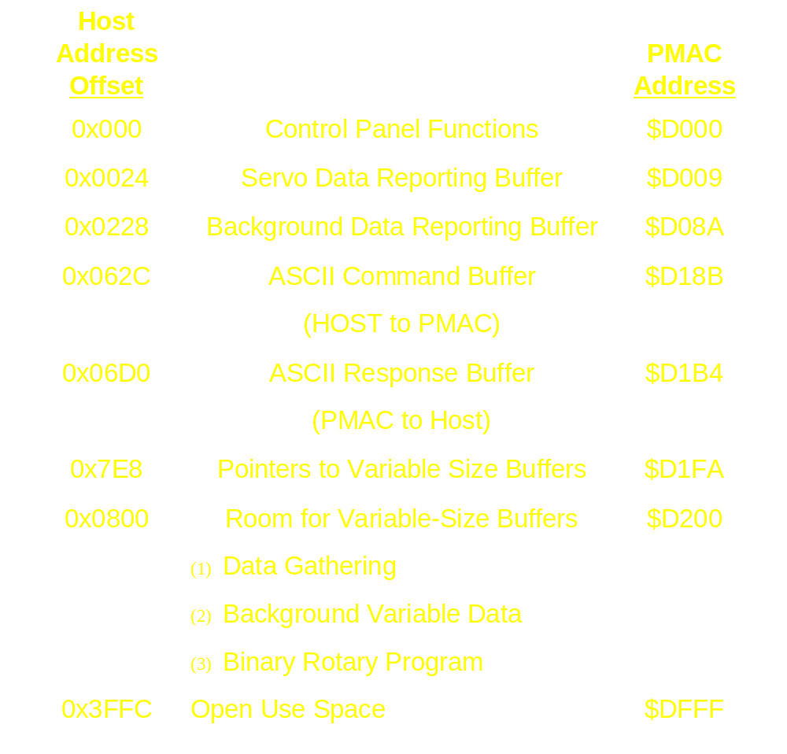
PMAC Dual-Ported RAM 内存图

Slide 54
PCOMM Dual Ported RAM
特性支持功能
Control Panel
Servo Time
Fixed Buffer
Background
Fixed Buffer
DPR
Features
Variable
Background
ASCII I/O
Binary Rotary
Buffer

Slide 55
PMAC 通讯软件
Name
Description
16-bit
32-bit
ACC-9P
PCOMM
Yes
No
ACC-9PN
PCOMM-32
No
Yes
ACC-9PT
PTALK OCX
No
Yes
ACC-9W
PMAC Executive
for Windows
Yes
No
PMAC Executive for
Windows 95,98, or NT
ACC-9WN
No
Yes
ACC-9DA
PMAC Executive
for DOS
Yes
No
PMAC NC
for Windows
ACC-33W
Yes
No
ACC-33WN
PMAC NC for
Windows 95,98, or NT
No
Yes

Slide 56
新的PMAC 软件
PMAC Panel - VI’s for LABView
PMAC 连通性 - OPC Server for different field busse ControlNet, DH+, DeviceNet, Ethernet

